Slide 2
Human Emotion Detection System
Submitted to:
Department of Computer Science and Engineering

Slide 3
Supervised by:
Prof. Ritika Bhatt
Team Members
1.Abhinav Nagar (0827CS201010)
2.Ajay Sonere (0827CS201019)
3.Ankit Buade (0827CS201033)
4.Deepak Patidar (0827CS201063)

Slide 4
Project Presentation Outline
Abstract
Introduction
Problem Statement
Project Objectives
Requirement Analysis
Models and Diagrams
Conclusions and Limitations

Slide 5
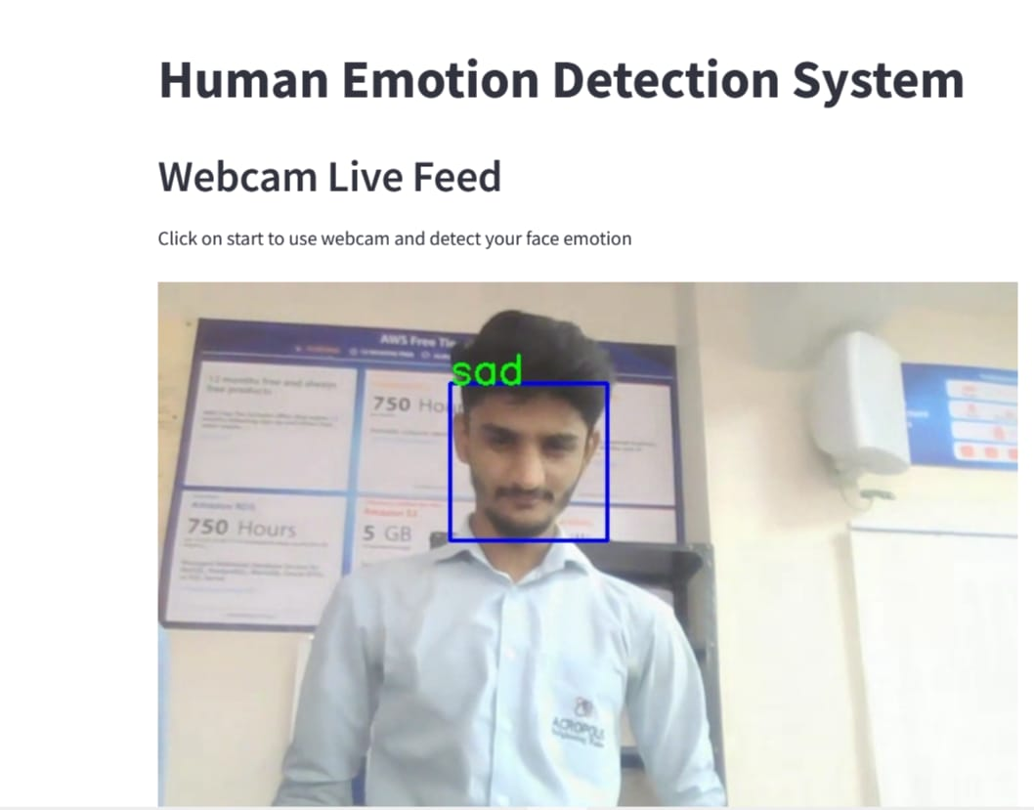
Abstract
Human Emotion Detection System is an artificial intelligence-based tool that uses computer vision, machine learning, and natural language processing algorithms to recognize and analyze human emotions. The system can detect emotions like happiness, sadness, anger, fear, surprise, disgust, and neutral from facial expressions

Slide 6
Introduction
Human Emotion Detection System is a cutting-edge technology that aims to revolutionize the way computers interact with humans. It uses advanced algorithms to detect and analyze emotions from various sources such as facial expressions. With the rapid advancement of artificial intelligence, it is now possible to develop systems that can understand human emotions and respond in a meaningful way.

Slide 7
Objectives
The aim of this system is to improve human-computer interaction by enabling machines to understand human emotions and respond appropriately.
Precision Emotion Recognition:Achieve accurate and precise recognition of human emotions through facial expressions.
Seamless Integration: Seamlessly integrate the emotion detection system into various technologies, enhancing human-machine interactions.

Slide 8
Requirement Analysis
Functional requirements
Emotion recognition accuracy: The system should accurately detect and categorize emotions from facial expressions
Data source integration: The system should be able to integrate with multiple data sources such as cameras, microphones, and sensors
Real-time processing
Emotion categorization

Slide 9
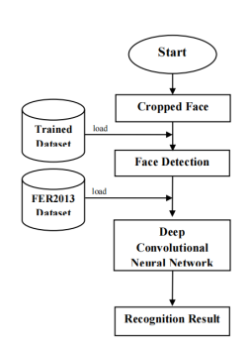
Diagrams
Flow Diagram

Slide 10
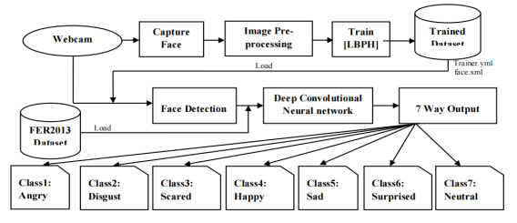
Diagram
System Diagram
Department of Computer Science Engineering

Slide 11
Resources required
Hardware: hardware such as camera A computer or server with sufficient processing power and memory is also needed for running the algorithms and storing data.
Software: Software tools for data preprocessing, machine learning, and deployment may be required, such as programming languages such as Python, libraries for data analysis and visualization such as NumPy, Pandas, and Matplotlib, and machine learning frameworks such as TensorFlow and PyTorch.
Data: A large amount of data is typically required for training the machine learning models
Department of Computer Science Engineering

Slide 12
Implementation
The implementation of a Human Emotion Detection System using Local Binary Patterns Histograms (LBPH) can involve the following steps:
Data Collection: Collect data from various sources such as cameras, microphones, and physiological sensors to obtain input for emotion detection.
Data Preprocessing: Preprocess the data to prepare it for analysis, such as removing noise, normalizing values, and transforming data into a format that is suitable for the analysis algorithms.
Face Detection: Detect faces in the images using a face detection algorithm such as Haar cascades or Single Shot MultiBox Detector (SSD).
Model Training: Train a learning model, such as a support vector machine (SVM) or a neural network, on the extracted features to learn the relationships between the features and emotions.
Department of Computer Science Engineering

Slide 13
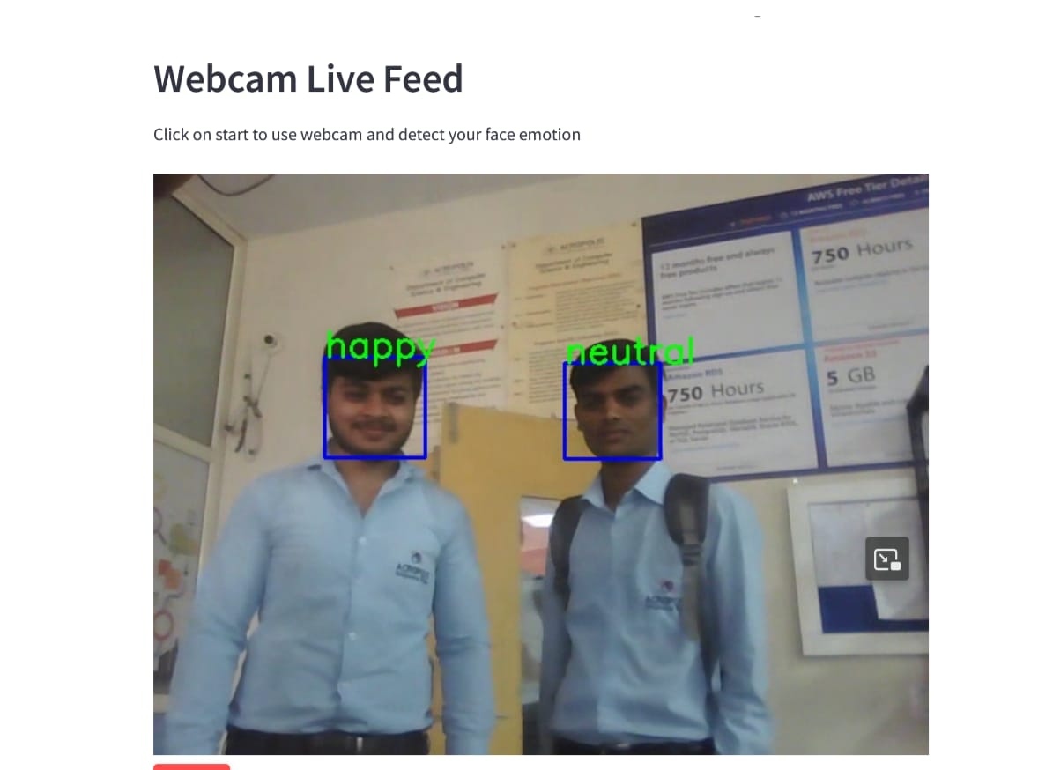
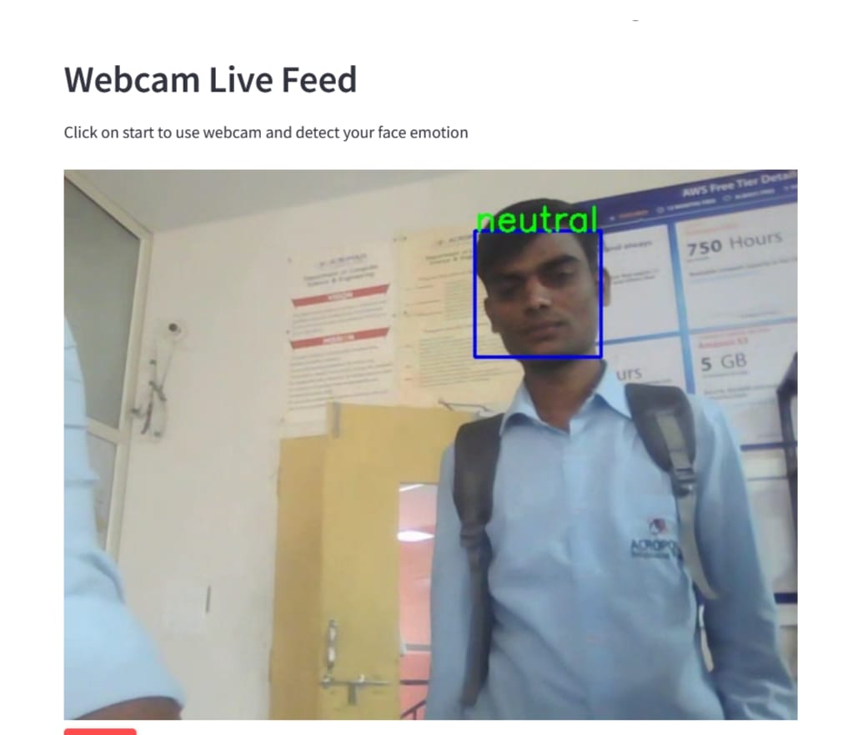
Implementation
Model Evaluation: Evaluate the performance of the trained models by testing on a validation data set and adjusting parameters as necessary.
Result Presentation: Present the results of the emotion detection to the user in a clear and concise manner, such as through a graphical user interface or an application programming interface.
Department of Computer Science Engineering

Slide 14
THANKS

